Slide 1
Breast Cancer Update for Primary Care
Dr Angela Esiwe
Salaried G.P
MRCGP,MRCGP,MRFSRH (1),DFSRH
Swingbridge surgery, Grantham.
24/6/20

Slide 2
Speakers
Dr Elisabetta Giannotti – Consultant Radiologist, Nottingham Breast Institute
Miss Georgette Oni- Consultant Plastic/Oncoplastic Breast Surgeon, Nottingham Breast Institute
Dr Angela Esiwe - Salaried G.P, Grantham.
Lisa Sawyers- Specialist Nurse Practitioner, Nottingham Breast Institute

Slide 3
Objectives
Case Studies of typical G.P cases (E.G/A.E/G.O)
Presentation
Investigations and Diagnosis at Breast clinic
Management
Complications
Tips on breast examination (L.S/G.O)
Criteria for referral Genetic counselling in a nutshell (G.O)
Post care support (G.O)
Q+ A

Slide 4
Introduction – Why talk about Breast Ca
Most common cancer in UK.
Early diagnosis = better prognosis
Life time risk: 1 in 8 women affected
Health promotion is paramount to prevention and early detection

Slide 5
Introduction – Challenges for G.P’s.
The ……..“ W’s’’…………
When to refer or not to Breast clinic?
Where to refer Lincs/Notts/Peterborough?
Which cases to ‘watch and wait’ or refer 2WW?
‘’inappropriate referrals’’
Patient’s expectation pre and after care

Slide 6
Dr Elisabetta Giannotti

Slide 7





NEW REFERRAL CLINIC
common themes primary management
when to worry
when to relax
Elisabetta Giannotti - Lisa Sawers
Nottingham Breast Institute

Slide 8

Summary
New referral clinic pathways
Symptoms: GOOD BAD UGLY

Slide 9
Why talk about Breast Cancer?
Breast cancer commonest cancer in UK.
Life time risk: 1 in 8 women in UK.
Challenges for G.P’s- “ W’s’’
- When to refer or not to Breast clinic?
- Where to refer Lincs/Notts/Peterborough?
- Which cases to ‘watch and wait’ or refer 2WW?
- ‘’inappropriate referrals’’
Role of a G.P in prevention, early diagnosis, after care.

Slide 10

NEW REFERRAL CLINIC
Nurse Practitioner/Surgeon
Radiological examination Mammogram
Ultrasound
outcome
History- clinical examination
Request images if necessary
+/- Biopsy
Patient discharged
BIOPSY
Patient suitable for results by letter
Patient come back for results/ COVID pathway results by phone

Slide 11

Opportunity for breast awareness

Slide 12

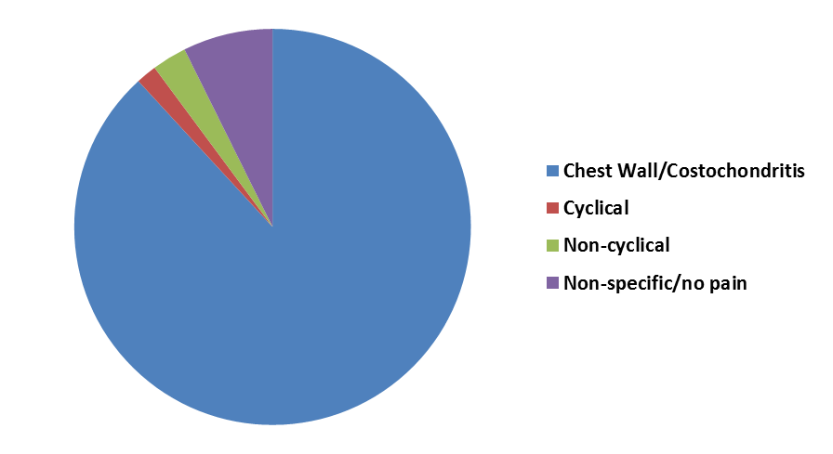
PAIN
< 40 Clinical examination
> 40 Screening mammogram (if not in the last 12 months)
Breast pain alone is not usually a sign of breast cancer and is much more likely to be either a benign breast condition or chest wall pain due to other factors
Cyclical breast pain
Non-cyclical breast pain
Chest wall pain- 88% of cases
Just pain: immediate referral not necessary!

Slide 13
LS breast pain video

Slide 14
PAIN - treatment
Chest wall / Costochondritis:
Reassure! - pain not a worrying symptom
Treat with NSAID gel for 4-6 weeks
  Works for all types of breast pain
  Includes the massage effect
  Gives them something to do!
Paracetamol, opiates etc will mask rather than treat
Ensure wearing an appropriate and supportive bra.
Consider checking vitamin D levels and supplement as necessary.
Heat can offer relief, such as hot water bottle or wheat bag
REST! Treat as an injury
True breast pain:
Regular simple analgesia and anti-inflammatory gel (for the massage effect) for 6 weeks.
High dose Oil of Evening Primrose (1g tds) or starflower oil.
Check Vitamin D levels- supplements
Appropriate and supportive bra
Hormonal contraceptive
Other complimentary treatments: acupuncture and homeopathy
Pre-menstrual breast pain is often due to increased water retention:
  Healthy well balance diet
  Weight control
  Low salt diet?
  Reduce caffeine intake
  magnesium and vitamin B6
The evidence for supplements and alternative therapies is mostly anecdotal, but many women find relief trying these methods.

Slide 15
NIPPLE DISCHARGE
SINGLE DUCT – MONOLATERAL- CLEAR BLOODY
MAMMOGRAM >35 + CYTOLOGY
Please refer!
MULTI DUCT / Bilateral / various colours (not blood)
Benign physiological/ smokers
Milky discharge- can persist for ~ 2 years post lactation ceasing
Please DON’T refer!
Gentle massage of the breast will often demonstrate that discharge come from multiple ducts or is bilateral

Slide 16
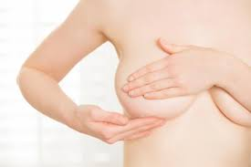
BREAST LUMP
<40 Target US
>40 Screening Mammogram + Ultrasound
If CYST: offer aspiration
If LUMP>30 CORE BIOPSY
LUMP<30 benign appearance: discharge
Please refer!

Slide 17
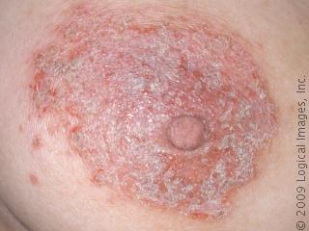
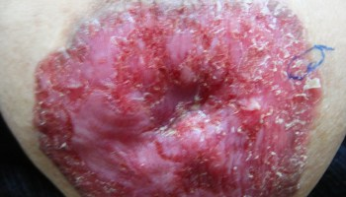
PAGET’S vs Eczema
Pagets:
Occurs almost exclusively in women
Most common around the menopause
Unilateral, persistent eczematous-type change of the nipple areola complex (Starts at tip of nipple) + erythema + scaling
Itching or burning sensation
Discharge and/or bleeding from the nipple
Ulceration
Destruction of the nipple
Inversion of the nipple
Sometimes palpable breast lump
Eczema:
Can occur anywhere on the breast- Paget’s exclusively on NAC
Any age affected
Usually Responds to topical Steroid treatment
Often history of atopic eczema with personal or family history of hay fever or asthma

Slide 18
PAGET’S vs Eczema
Management Eczema
Avoid aggravating cause
Moisturisers
Topical corticosteroid cream or ointment
Oral antihistamine if itching is troublesome
Patch testing if allergen suspected
Management Paget
Mammogram >35 yo
Punch biopsy of nipple
Surgery etc
Treat first! If no sustained response, please refer

Slide 19
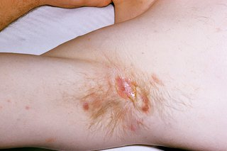
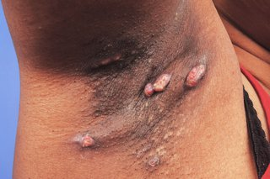
HIDRADENITIS SUPPURATIVA
Painful, long-term skin condition that causes abscesses and scarring on the skin.
Causes a mixture of red boil-like lumps, blackheads, cysts, scarring and channels in the skin that leak pus
Will usually affect Breasts, Groins, Axillas and buttocks
Difficult to treat, often requires dermatology input
Don’t refer!

Slide 20
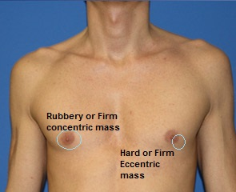
GYNAECOMASTIA
Causes:
Excess oestrogens: puberty testicular tumours adrenocortical tumours hyperthyroidism
Disturbance in oestrogen metabolism: alcoholism chronic liver disease
Decreased androgens: Ageing, primary gonadal failure – Klinefelters, viral orchitis, Secondary gonadal failure: pituitary or hypothalamic disease
Disturbance in androgen binding: chronic renal failure, HIV
Medications (e.g. Spironolactone, Digoxin, cimetidine, tricyclic antidepressants, Steroids and many others)
Other drugs (e.g. marijuana, alcohol, anabolic steroids amongst others)
Cancer | Gynaecomastia
Eccentric lump | Concentric lump
Non-painful | Painful / tender (in early stages)
Hard | Rubbery
Very Rare, especially in <40 | Common

Slide 21
GYNECOMASTIA
CAUSE | TREATMENT
Pubertal | Will usually spontaneously resolve <3 years
Hypogonadism | Refer to Endocrinologist
Drug/Lifestyle cause | Remove/correct underlying cause
Idiopathic | Tamoxifen
Obesity | Advise to lose weight
Old age | Normal aging process

Slide 22
MALE BREAST CANCER
Age >60 (majority)
Rare- 1% of breast cancers
↑Nodal involvement and higher stage disease
lump in the breast area, more likely away from the nipple, painless
oozing from the nipple (a discharge) that may be blood stained
swelling of the breast
a sore (ulcer) in the skin of the breast
a nipple that is pulled into the breast (called nipple retraction)
lumps under the arm
a rash on or around the nipple

Slide 23
Miss Georgette Oni/ Dr A. Esiwe

Slide 24
Case Study 1
Miss A is 33 yrs old presents with 2/12 hx of a painful breast lump.
LMP= 3/12 ago on Cerezette (POP)
Pain – not sure if related to her cycle
Examination: generally ‘lumpy’ breasts.
Referred to breast clinic
FHx: Sister diagnosed with Breast Ca 3yrs ago age 42, Mum age 46, Grandma in her 50’s.

Slide 25
DDx
Benign breast lump
  Eg fibroadenoma, benign phyllodes
Exclude malignancy
  Malignant Phyllodes
  DCIS/Inv cancer

Slide 26
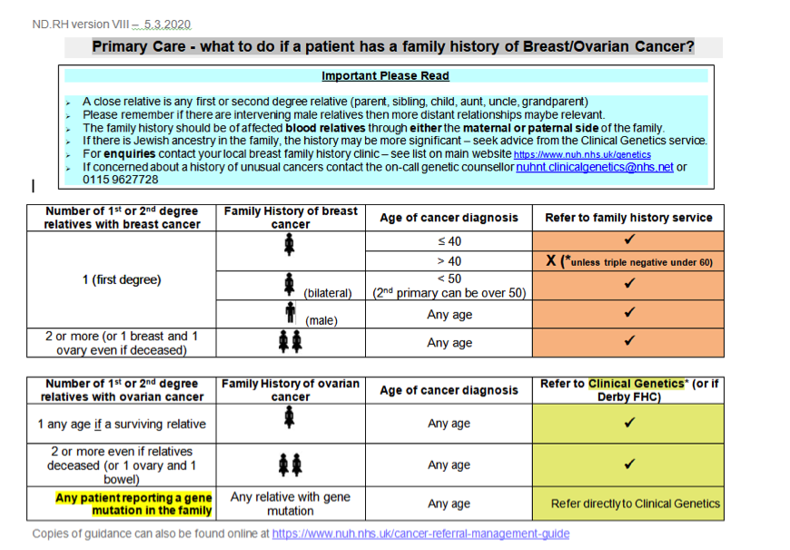

Slide 27
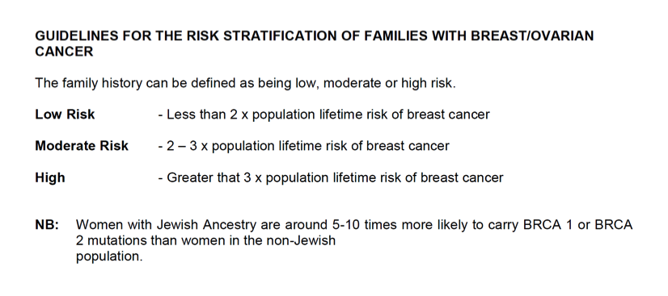

Slide 28
Risk stratification and screening
Low risk – no intervention
Moderate risk – annual MMGs from age of 40
High risk – annual MMGs from age of 35
Genetic syndromes eg BRCA – MMGs from age of 30 and MRI

Slide 29
Case 2
Mrs B. Is a 43yr old with lump in her left breast
Examination: Left breast- 2cm lump
Mum had cancer in her 40’s
Plan: Refer 2WW Breast clinic- Notts City Hosp
DDx: Breast cancer, benign breast lump

Slide 30
Management
Triple assessment
  Palpable lump
  Seen on MMG and USS
  Gd 2, 26mm, Node +ve, ER +ve, Her2 -ve
FHx assessed –tested
  BRCA 2

Slide 31
Indications for NACT
Age
Grade
Tumour size
Nodal involvement
Her 2 status
Inflammatory breast cancer
Genetics, fertility etc
Down-staging to facilitate BCS

Slide 32
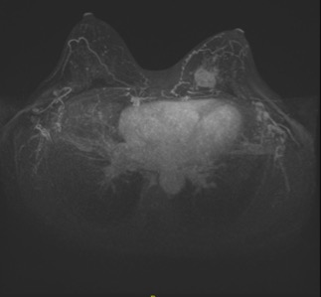
Mgmt ctd
NACT – partial response
Surgery
Radiotherapy
Endocrine therapy
Oopherectomy

Slide 33
Case 3
Mrs C. Is a 78yr old presents with 3/12 history of left arm pain. Pain radiates occasionally to breast
No history of injury or trigger.
Multiple co-morbidities
Examination:
MSK- left arm-NAD
Breast- Large breast lump >5cm, fixed with nipple inversion
Axilla: NAD

Slide 34
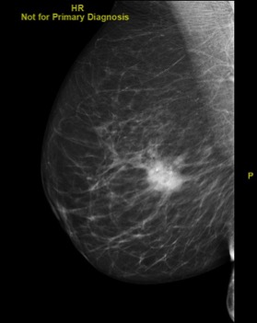
Case 3
Diagnosis: Breast cancer
Inv: ER +ve ,PR +ve, Her 2 –ve.
Discussion – not keen for surgery
Endocrine tablet therapy

Slide 35
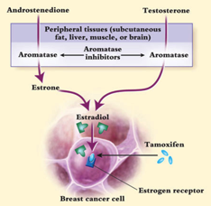
Primary endocrine treatment
Not safe for surgery
  NACOP surgery still best long term treatment
Side effects
  Menopausal, aches and pains
  Dexa scan
Monitoring
  Nurse led clinic
  Caliper measurements, imaging
Resistance - 1st, 2nd, 3rd line treatments

Slide 36


MALE BREAST CANCER
Age >60 (majority)
Rare- 1% of breast cancers
↑Nodal involvement and higher stage disease
lump in the breast area, more likely away from the nipple, painless.
oozing from the nipple (a discharge) that may be blood stained
swelling of the breast
a sore (ulcer) in the skin of the breast
a nipple that is pulled into the breast (called nipple retraction)
lumps under the arm
a rash on or around the nipple

Slide 37
Quick fire round

Slide 38
CASES
35 years old attends GP clinic for single duct discharge of yellow colour
During the visit nipple discharge is multiduct
WHAT TO DO?
NO REFERRAL NEEDED

Slide 39
CASES
54 years old attends GP clinic for rush upper outer right breast away from the nipple
Clinical examination confirm the rush but no palpable lump noted.
WHAT TO DO?
? Eczema
Treat first! If no sustained response, please refer

Slide 40
CASES
53 years old attends GP clinic because she can feel a new lump in the right breast
Last mammogram 13 months ago
WHAT TO DO?
REFERRAL NEEDED

Slide 41
CASES
37 years old attends GP clinic for single duct discharge of red colour
During the visit nipple discharge is single duct and of bright red colour
WHAT TO DO?
REFERRAL NEEDED

Slide 42
CASES
52 years old attends GP clinic for pain right breast
Clinical examination normal
the patient can not feel lump and she had last screening mammogram 6 months ago
WHAT TO DO?
TREAT
NO IMMEDIATE NEED TO REFER

Slide 43
CASES
24 years old pain both breast
Clinical examination normal
the patient can not feel lump
WHAT TO DO?
TREAT
NO IMMEDIATE NEED TO REFER

Slide 44
Breast Pain
No refer!
Breast Lump
Single nipple discharge clear or bloody
Paget disease
Refer!
Multiple bilateral nipple discharge
Idroadenites
Eczema
No refer!

Slide 45
Any questions?

Slide 46
Lincolnshire Breast care Nurses
Patients can contact for advice nurses on
Grantham: 01476 593945
Boston: 01205 445998
Lincoln: 01522 537662
Local Website -https://www.ulh.nhs.uk/services/breast-surgery/
Other’s: Breast cancer care, Macmillian cancer support , coppafeel

